Slide 1
Screenshots of SQL Queries and their output

Slide 2
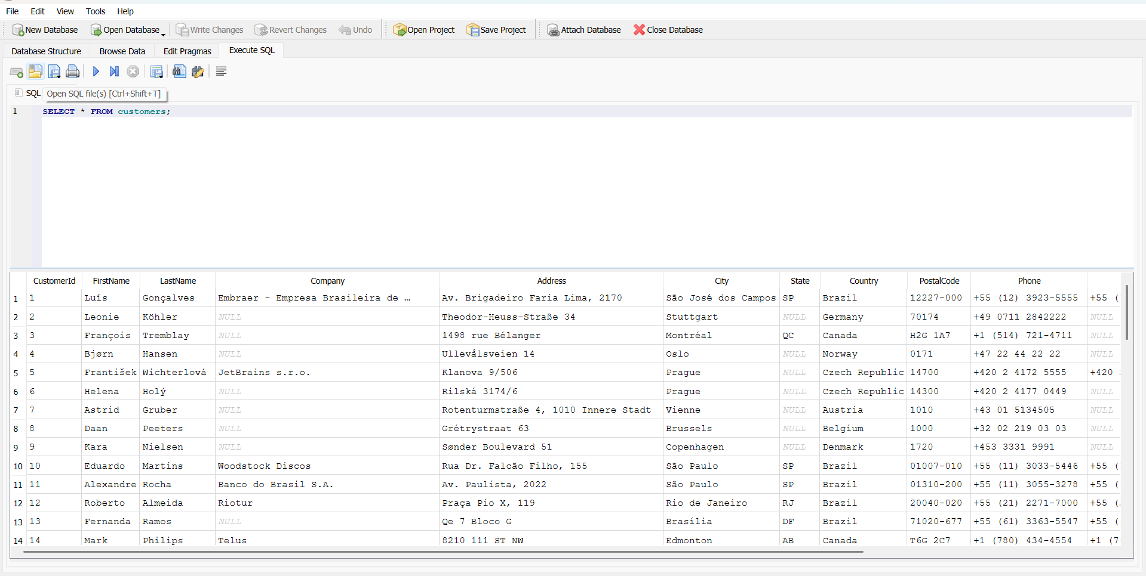
Query 1: Retrieve all customers

Slide 3
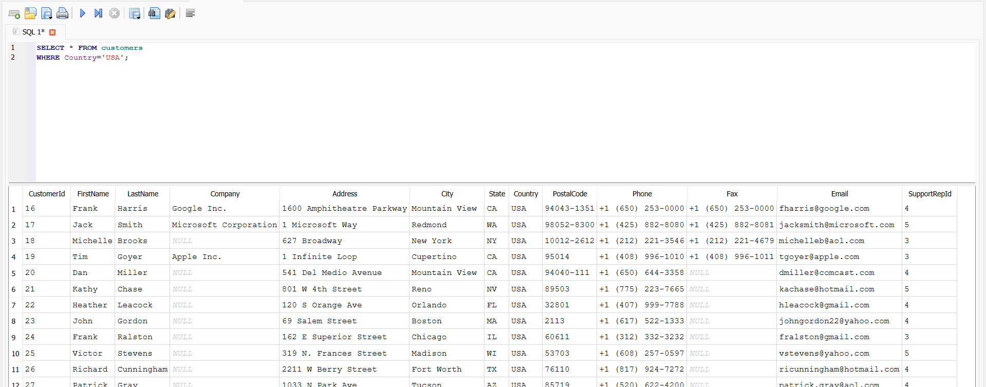
Query 2: Filter USA customers

Slide 4
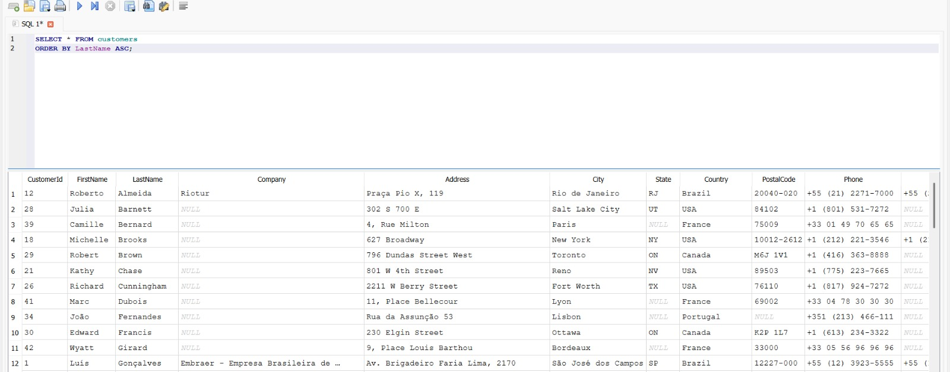
Query 3: Sort Customers Alphabetically

Slide 5
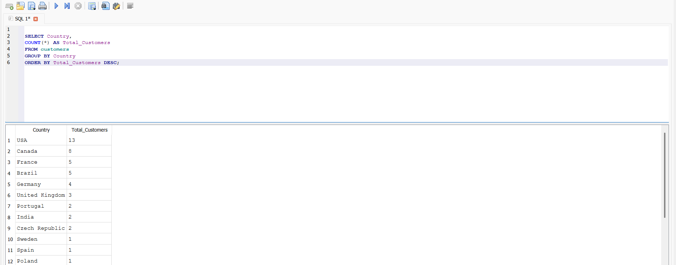
Query 4: Count Customers by Country

Slide 6
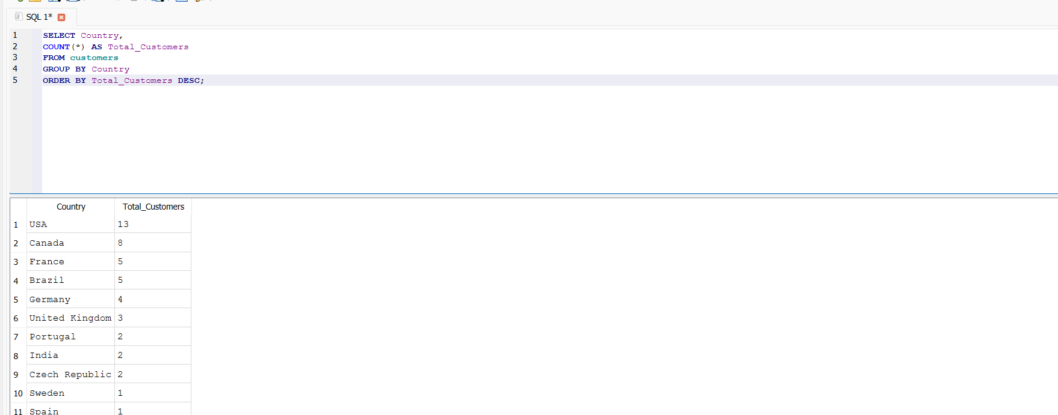
Query 5: Calculate Average Invoice Value

Slide 7
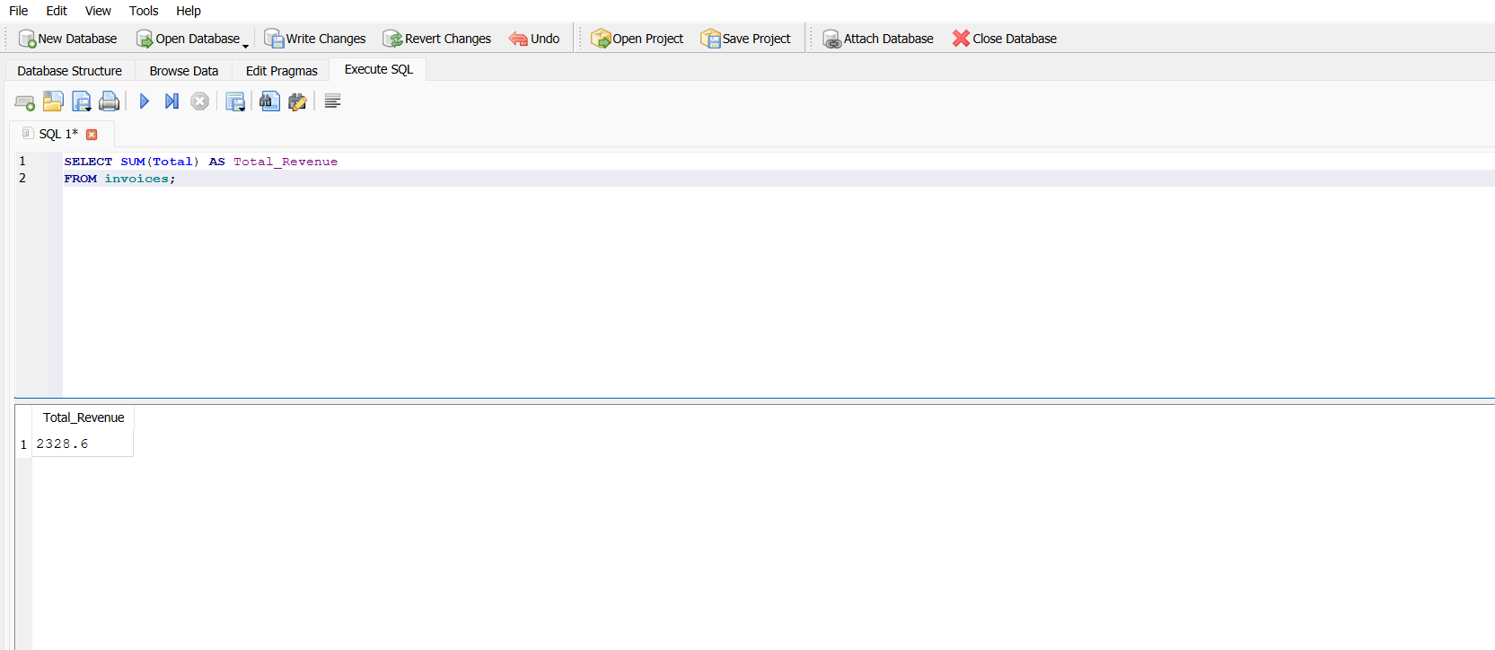
Query 6: Calculate Total Revenue

Slide 8
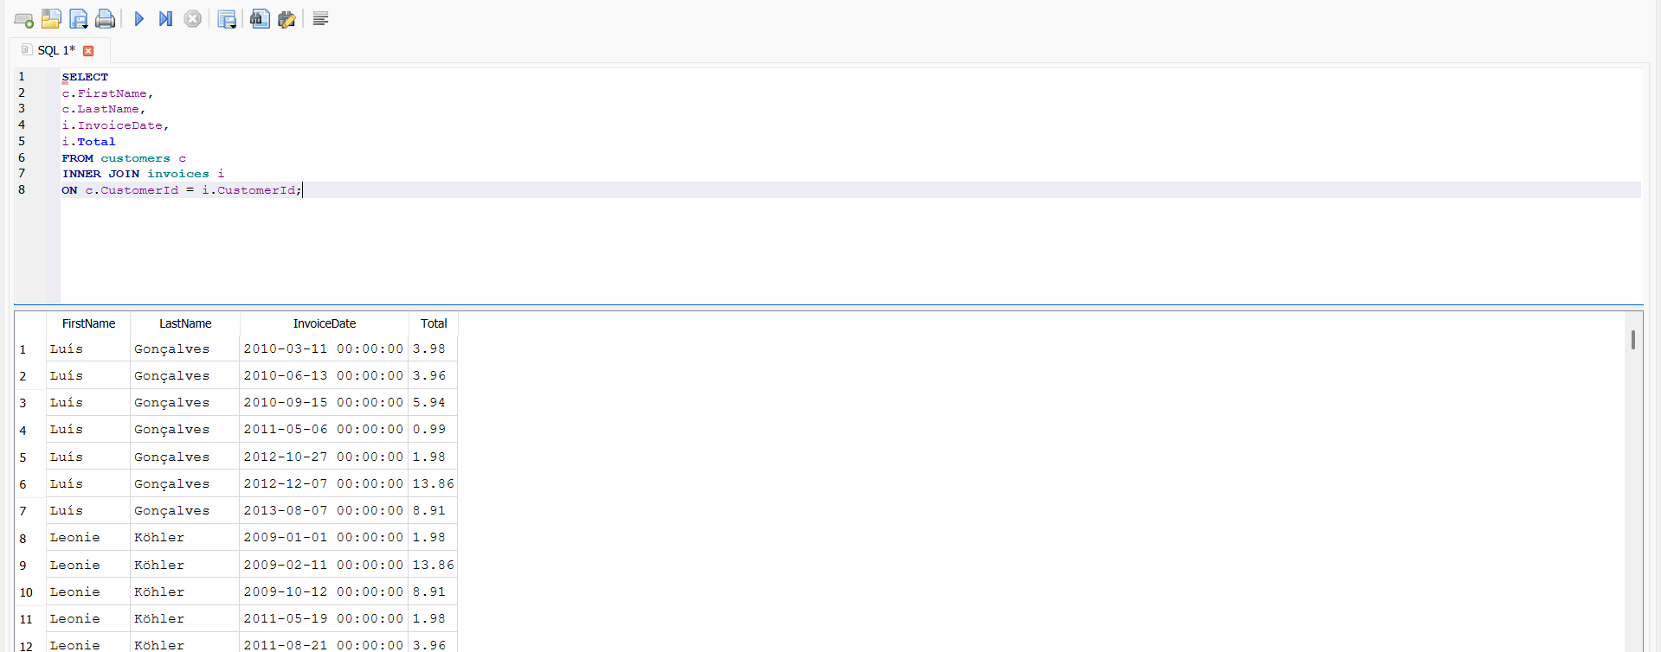
Query 7: Customer Invoice Analysis

Slide 9
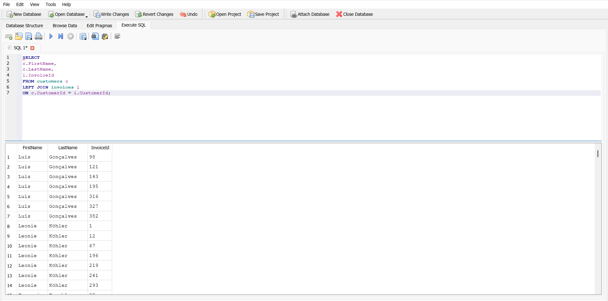
Query 8: Customer and Invoice Overview

Slide 10
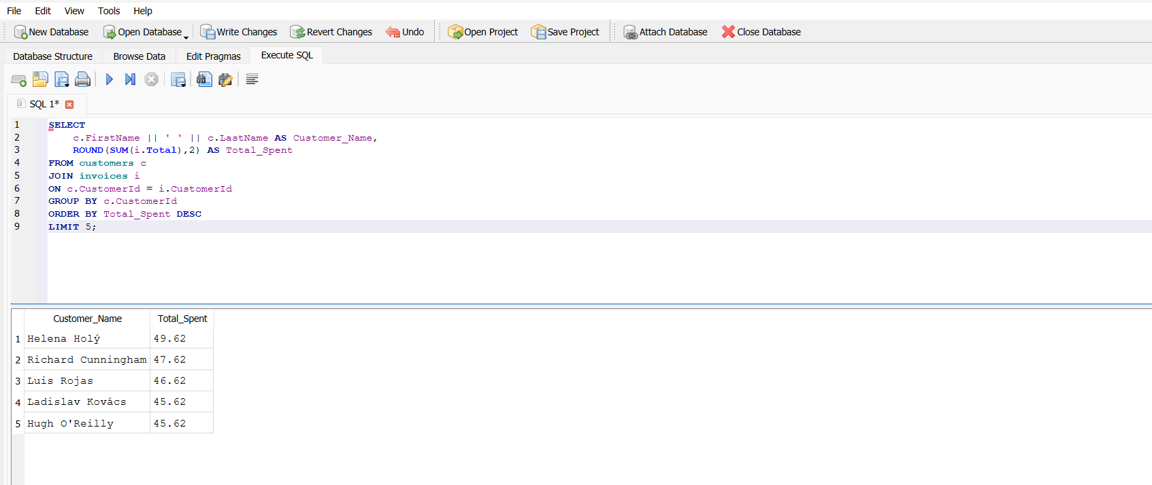
Query 9: Top 5 Customers by Revenue

Slide 11
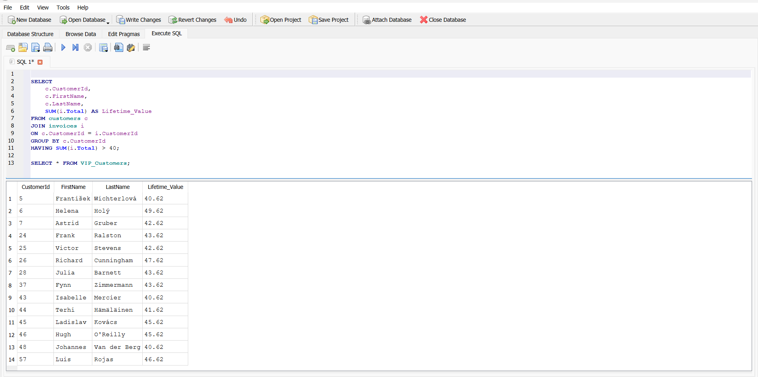
Query 10: VIP customers

Slide 12
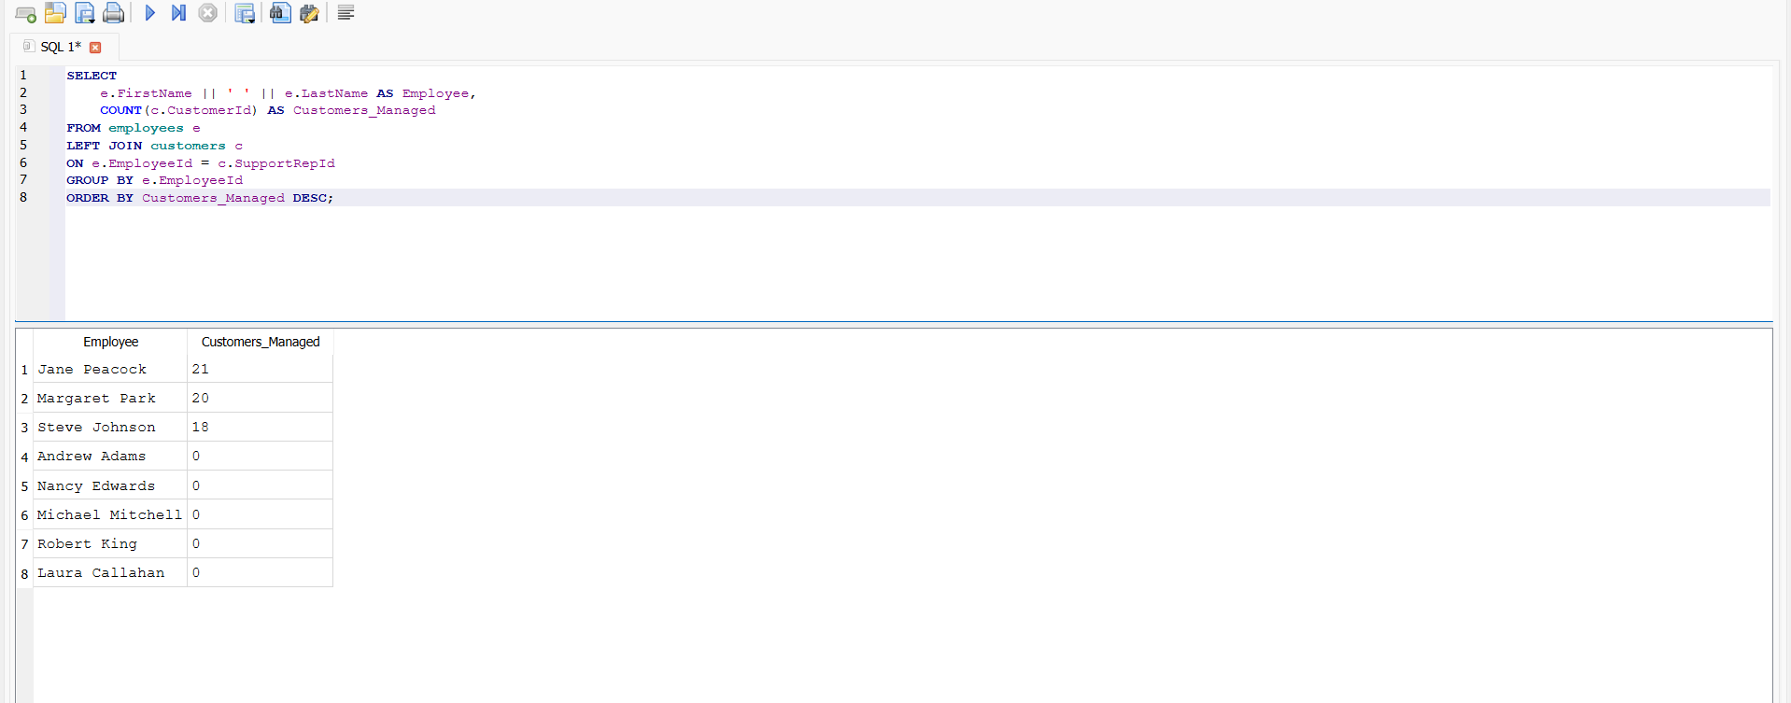
Query 11:Employee Performance Dashboard Query

Slide 13
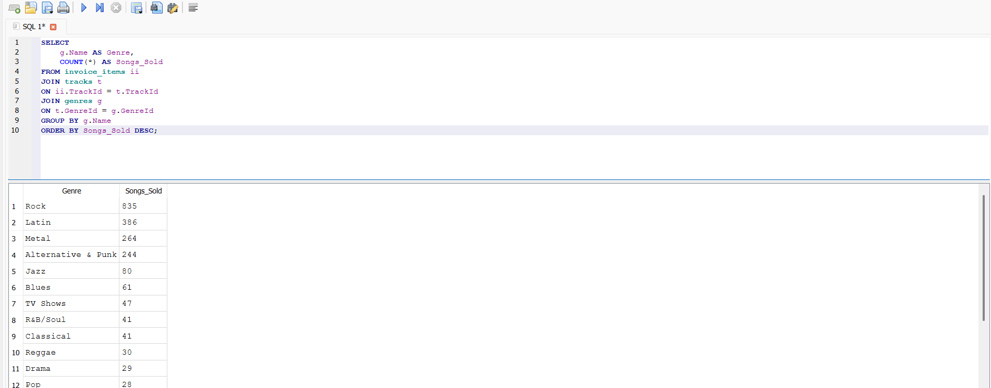
Query 12:Best-Selling Music Genres

